Slide 1

An introduction to Multi-Armed Bandits for Wireless Communications
Francesc Wilhelmi, Boris Bellalta, Cristina Cano

Slide 2
PART I Bandits Theory

Slide 3
Introduction

Slide 4
Introduction Basics on MABs
The Multi-Armed Bandits (MABs) problem addresses the exploration-exploitation trade-off in face of uncertainty
Classically, a gambler attempts to maximize the profits among a set of slot machines
Often, we refer to the expected cumulative regret to quantify the performance of a given action-selection strategy
Take the oracle’s policy as a reference
Convergence analysis: anytime, fixed-horizon or asymptotic optimality

Slide 5
Introduction Motivation
MABs are a class of sequential learning framework that allow to address the tradeoff between exploration and exploitation in face of uncertainty
Suits problems with unavailable or incomplete information
There’s no need of modeling states or trying to learn them (which entails added complexity)
Many different MABs-based models have been provided for several types of problems

Slide 6
Introduction Important References of the MAB Problem
Baseline:
Katehakis, M. N., & Veinott Jr, A. F. (1987). The multi-armed bandit problem: decomposition and computation. Mathematics of Operations Research, 12(2), 262-268.
Gittins, J., Glazebrook, K., & Weber, R. (2011). Multi-armed bandit allocation indices. John Wiley & Sons.
Auer, P., Cesa-Bianchi, N., & Fischer, P. (2002). Finite-time analysis of the multiarmed bandit problem. Machine learning, 47(2-3), 235-256.
Auer, P., Cesa-Bianchi, N., Freund, Y., & Schapire, R. E. (1995, October). Gambling in a rigged casino: The adversarial multi-armed bandit problem. In Foundations of Computer Science, 1995. Proceedings., 36th Annual Symposium on (pp. 322-331). IEEE.
Overviews:
Bubeck, S., & Cesa-Bianchi, N. (2012). Regret analysis of stochastic and nonstochastic multi-armed bandit problems. Foundations and Trends® in Machine Learning, 5(1), 1-122.
Vermorel, J., & Mohri, M. (2005, October). Multi-armed bandit algorithms and empirical evaluation. In European conference on machine learning (pp. 437-448). Springer, Berlin, Heidelberg.

Slide 7
MABs Taxonomy

Slide 8
MABs Taxonomy According to the Reward Generation Process
Stochastic
The reward is generated according to a specific stochastic process
Literature: [5]
Non-stochastic:
No statistic assumption can be done on the reward generation process
Literature: [5, 7]

Slide 9
MABs Taxonomy Other Categorizations (I)
More subtle categorization on reward generating process:
Stateful (Markovian): every arm is associated with some finite state space
Stateless: arms do not have specific state
Adversarial: different learners attempt to maximize a given reward function
Other types:
Contextual: in addition to the reward, some other useful information is provided to the agent
Combinatorial: there is a relationship between arms
Mortal: arms are available for a certain amount of time
…

Slide 10
MABs Taxonomy Other Categorizations (II)
Stateful (Markovian)
Stateless
(Stochastic)
Adversarial
Rested (frozen/sleeping): the state of a given arm only changes when pulled
Restless: the state of every arm changes regardless of the player’s action
The reward generation process is stochastic (stationary or non-stationary density function), and is independent and identically distributed (IID)
Rewards generation cannot be attributed to any stochastic assumption
Oblivious adversaries
Non-oblivious adversaries (min-max strategies)

Slide 11
MABs Taxonomy Other Categorizations (III)
Contextual bandits [8-9]:in addition to the reward, some other useful information is provided to the agent
Combinatorial bandits [10-11]: there is a relationship between arms
Mortal bandits [12]: arms are available for a certain amount of time
MABs with multiple plays [13-15]: a player can pick several arms simultaneously
Pure exploration [16-17]: gain the most knowledge over t by exploring, in order to maximize the likelihood of picking the best arm in t+1
Dueling bandits [18]: the player chooses a pair of arms in each round and observe only their performances (duel between arms)

Slide 12
Well-known Algorithms

Slide 13
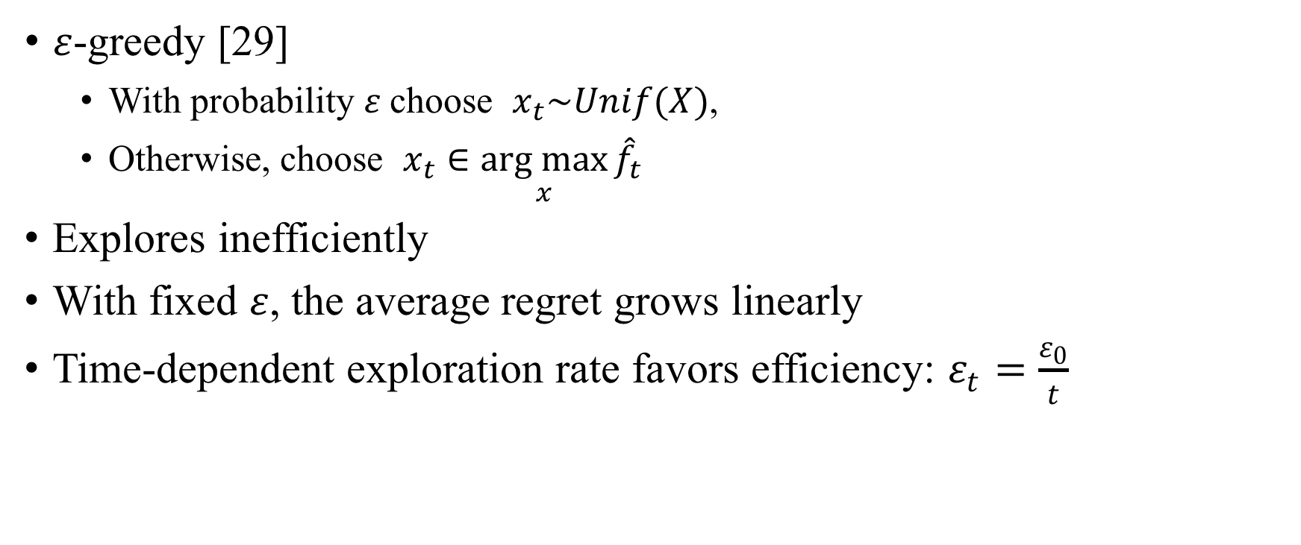
Well-known Algorithms Greedy Learning
$ε$-greedy [29]
With probability $ε$choose $x_{t}\sim Unif(X)$,
Otherwise, choose $x_{t}∈\underset{x}{arg max}{{\hat{f}}_{t}}$
Explores inefficiently
With fixed $ε$, the average regret grows linearly
Time-dependent exploration rate favors efficiency: $ε_{t}=\frac{ε_{0}}{t}$

Slide 14
Well-known Algorithms Optimistic Learning
Upper Confidence Bound (UCB) [3, 28]
Assumes certain distributions for the rewards and picks the optimal arm accordingly
The action-selection process not only takes the magnitude of the reward into account, but the estimated deviations

Slide 15
Well-known Algorithms Probability Matching Learning
Thompson sampling [30]
Has been shown to achieve strong performance guarantees, often better than those warranted by UCB [31, 32, 33]
It constructs a probabilistic model of the rewards and assumes a prior distribution of the parameters of said model – Then, it chooses the arm matching the probability of being optimal
Very popular because it is computationally cheap and offers good results

Slide 16
Single-Agent vs Multi-Agent MABs

Slide 17
Single-Agent vs Multi-Agent MABs
SA-MAB: mainly concerned on sequential online decision making problem in an unknown environment
MA-MAB: where Game Theory and MABs meet and complement each other (competition between agents)

Slide 18
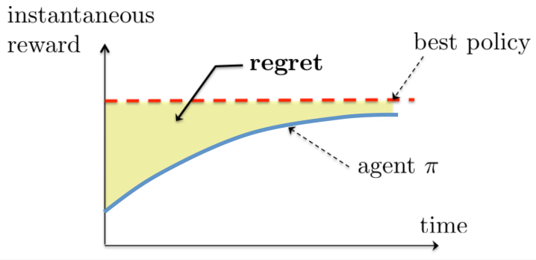
Single-Agent vs Multi-Agent MAB Single-Agent
Baseline: [19, 20]
Properties:
Stationarity of the environment
Pure exploration-exploitation
The Regret measurement is completely meaningful in this setting
State-of-the-Art performance bounds:
Lai and Robbins, 1985
Anantharam et al., 1987 (multiple plays)

Slide 19
Single-Agent vs Multi-Agent MAB Multi-Agent
Properties:
Non-stationarity of the environment
Nexus with Game Theory
Adversarial MABs is a sub-class of the Multi-Agent MAB problem
Models:
Decentralized – Selfish behavior
Distributed – Communication among agents
Centralized – Correlated Equilibria

Slide 20
Adversarial MABs

Slide 21
Adversarial MABs Introduction
Adversarial MABs typically frame to decentralized/distributed problems, where different learners compete for the same resources
According to the way rewards are revealed, we find:
Full information game: the player knows the reward of all the actions
Partial information game: the player only knows the reward of the played action
The notions of Internal and External regret are very important

Slide 22
Adversarial MABs Nexus with Game Theory
N-player game whereby player i competes with N-1 opponents
The goal is to determine convergence to some kind of equilibrium
In two-person zero-sum games, NE can be achieved if both players adopt an external-regret minimizing strategy. However, this does not hold for general N-player games!
We need to provide internal-regret minimizing strategies in order to converge to a Correlated Equilibrium (holds for the empirical joint frequencies)

Slide 23
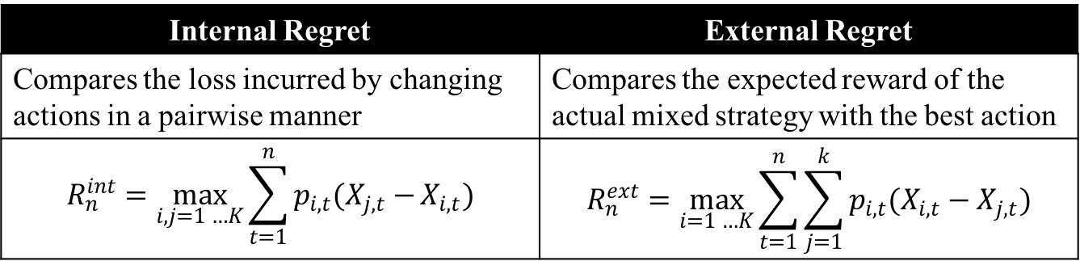
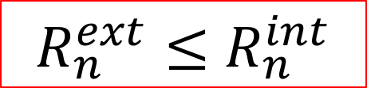
Adversarial MABs Internal and External regret
Internal Regret | External Regret
Compares the loss incurred by changing actions in a pairwise manner | Compares the expected reward of the actual mixed strategy with the best action
$$R_{n}^{int}=\max_{i,j=1 …K}{\sum_{t=1}^{n}{p_{i,t}(X_{j,t}−}}X_{i,t})$$ | $$R_{n}^{ext}=\max_{i=1 …K}{\sum_{t=1}^{n}{\sum_{j=1}^{k}{p_{i,t}(X_{i,t}−X_{j,t})}}}$$
$R_{n}^{ext}≤$ $R_{n}^{int}$

Slide 24
Adversarial MABs External-regret minimizing Algorithms
Weighted Average Prediction (WAP)
Hedge [4], variant of [21] for full information games
EXP3 [2]
Following the Perturbed Leader (FPL) [22], an online learning extension of [23]
Implicitly Normalized Forecaster (INF) Algorithm [24, 25]
Internal-Regret Minimizing Algorithm [26]

Slide 25
Adversarial MABs Internal-regret minimizing Algorithms
External-regret minimizing algorithms have been shown to work only for N = 2 players, thus NE or CE cannot be guaranteed for N ≥ 3
However, if every player uses an internal-regret minimizing strategy, “the joint empirical frequencies of plays converge to a correlated equilibrium”
The Experimental Regret Testing (ERT) [27] has been shown to exhibit internal-regret minimization

Slide 26
PART II Bandits in Wireless Communications

Slide 27
Previous Work

Slide 28
Previous Work MABs in Wireless Communications
MP-MABs for Opportunistic Spectrum Access [34-38]
Joint Channel Selection and Power Control in Cognitive Radio Networks [39]
Distributed inter-cell interference coordination [40]
Distributed user association in small cell networks [41]
Multi-path routing [42]
Dynamic rate and channel selection [43]
Unlicensed LTE/WiFi Coexistence [44]

Slide 29
Previous Work MP-MABs in Cognitive Radio problems
Cognitive Radio problems have raised attention, due to its decentralized (or distributed) nature
Therefore, the MP-MABs setting have been shown to properly fit to Cognitive Radio Networks
Several efforts have been done to provide mechanisms whereby multiple users converge to the optimal solution
Baseline [45]
Combinatorial approach [46, 47]
TDFS approach [48]
User-specific penalties [39]
Calibrated Forecasting [37]

Slide 30
Previous Considerations

Slide 31
Previous Considerations Typical Assumptions
Remarkable guarantees (convergence, performance, etc.) are often achieved only if certain assumptions hold:
Assumption | Drawbacks
All the players use the same strategy | Not feasible in dense and heterogeneous scenarios
The number of users is fixed and known | While the former implies that the network remains static, the latter entails communication or additional hardware
User-specific penalties are applied | A strong knowledge on the scenario must be known on before-hand
The reward generation process is relaxed and only depends on the own actions | Unfeasible in potentially overlapping scenarios, where the outer interference severely affects to the performance of a given WN

Slide 32
Previous Considerations Reward Distributions
Typical action-selection strategies assume well-known distributions (e.g., Gaussian) for the reward, which allows to effectively address the exploration-exploitation trade-off
However, reward distributions are hard to model in WNs, especially in adversarial environments
Then, performance guarantees cannot be assured
Nevertheless, good results have been shown on assuming Gaussian distributions for the Spatial Reuse problem [49, 50]

Slide 33
Use Case – Learning in Adversarial WLANs

Slide 34
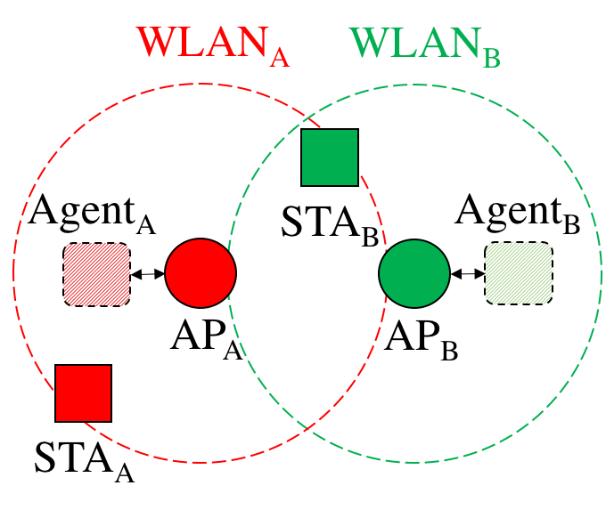
Use Case – Learning in Adversarial WLANs Learning Procedure (I)
In practice, the AP may incorporate an agent that performs learning operations according to the information received
Extensions of the decentralized case would entail communication and cooperation between agents

Slide 35
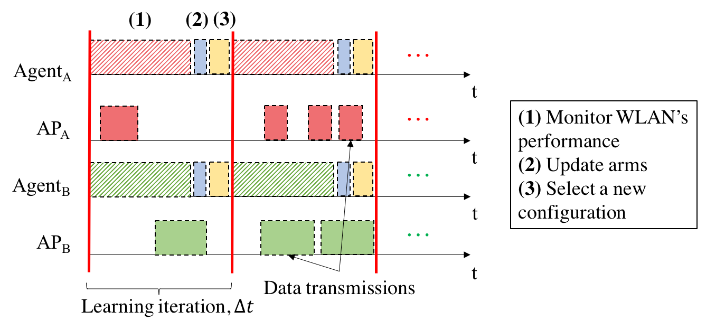
Use Case – Learning in Adversarial WLANs Learning Procedure (II)

Slide 36
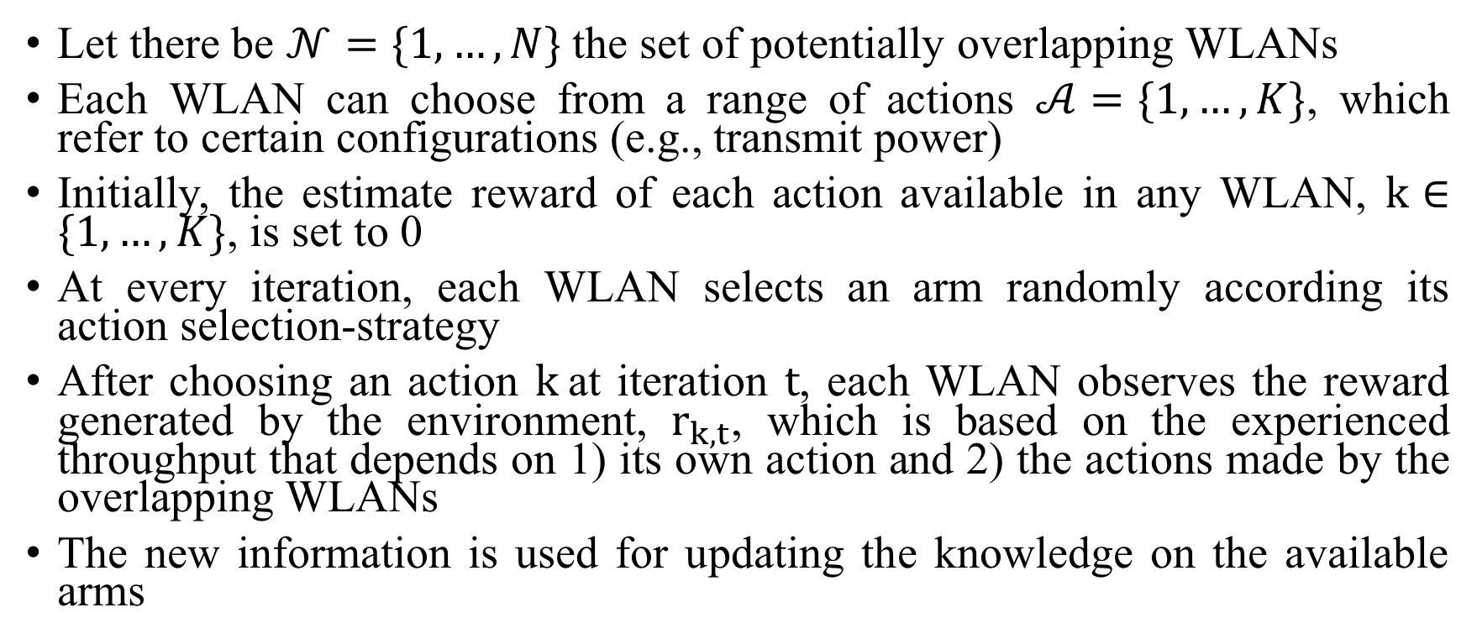
Use Case – Learning in Adversarial WLANs MABs formulation
Let there be $𝒩=\{1, …, N\}$ the set of potentially overlapping WLANs
Each WLAN can choose from a range of actions $𝒜=\{1, …, K\}$, which refer to certain configurations (e.g., transmit power)
Initially, the estimate reward of each action available in any WLAN, $k∈\{1, …, K\}$, is set to 0
At every iteration, each WLAN selects an arm randomly according its action selection-strategy
After choosing an action $k$at iteration $t$, each WLAN observes the reward generated by the environment, $r_{k,t}$, which is based on the experienced throughput that depends on 1) its own action and 2) the actions made by the overlapping WLANs
The new information is used for updating the knowledge on the available arms

Slide 37
Use Case – Learning in Adversarial WLANs Reward Generation
The reward is generated after a WLAN (or a set of WLANs) makes an action
It may be “selfish” or “collaborative”, according to the performance measure considered
The reward quantifies the performance experienced by the WLAN, so it may refer to:
Throughput
Packets sent
Delay
…

Slide 38
Use Case – Learning in Adversarial WLANs Reward Normalization
It is very important to normalize the obtained reward (which may be of great magnitude), in order to let the algorithms operate properly
However, normalization is done according to the optimal performance, which may be unknown and unfeasible to be derived
Thus, reasonable upper bounds can be provided for normalization
Maximum achievable data rate
Theoretical capacity
…

Slide 39
Some Conclusions

Slide 40
Some Conclusions
The learning process in wireless networks can be really slow
We need to question ourselves: is it worth?
Convergence guarantees may not exist, neither logarithmic regret decreasing
Decentralized settings are, in practice, unfeasible
However, performance maximization can be provided
Feasibility of applying learning in wireless networks
Distributed (message exchanging)
Centralized system (correlated equilibrium)

Slide 41
References
[1] Katehakis, M. N., & Veinott Jr, A. F. (1987). The multi-armed bandit problem: decomposition and computation. Mathematics of Operations Research, 12(2), 262-268.
[2] Gittins, J., Glazebrook, K., & Weber, R. (2011). Multi-armed bandit allocation indices. John Wiley & Sons.
[3] Auer, P., Cesa-Bianchi, N., & Fischer, P. (2002). Finite-time analysis of the multiarmed bandit problem. Machine learning, 47(2-3), 235-256.
[4] Auer, P., Cesa-Bianchi, N., Freund, Y., & Schapire, R. E. (1995, October). Gambling in a rigged casino: The adversarial multi-armed bandit problem. In Foundations of Computer Science, 1995. Proceedings., 36th Annual Symposium on (pp. 322-331). IEEE.
[5] Bubeck, S., & Cesa-Bianchi, N. (2012). Regret analysis of stochastic and nonstochastic multi-armed bandit problems. Foundations and Trends® in Machine Learning, 5(1), 1-122.
[6] Vermorel, J., & Mohri, M. (2005, October). Multi-armed bandit algorithms and empirical evaluation. In European conference on machine learning (pp. 437-448). Springer, Berlin, Heidelberg.
[7] Auer, Peter, et al. "The nonstochastic multiarmed bandit problem." SIAM journal on computing 32.1 (2002): 48-77.
[8] Slivkins, A. (2014). Contextual bandits with similarity information. Journal of Machine Learning Research, 15(1), 2533-2568.

Slide 42
References
[9] Agrawal, S., & Goyal, N. (2013, February). Thompson sampling for contextual bandits with linear payoffs. In International Conference on Machine Learning (pp. 127-135).
[10] Cesa-Bianchi, N., & Lugosi, G. (2012). Combinatorial bandits. Journal of Computer and System Sciences, 78(5), 1404-1422.
[11] Chen, W., Wang, Y., & Yuan, Y. (2013, February). Combinatorial multi-armed bandit: General framework and applications. In International Conference on Machine Learning (pp. 151-159).
[12] Chakrabarti, D., Kumar, R., Radlinski, F., & Upfal, E. (2009). Mortal multi-armed bandits. In Advances in neural information processing systems (pp. 273-280).
[13] Anantharam, V., Varaiya, P., & Walrand, J. (1987). Asymptotically efficient allocation rules for the multiarmed bandit problem with multiple plays-Part I: IID rewards. IEEE Transactions on Automatic Control, 32(11), 968-976.
[14] Anantharam, V., Varaiya, P., & Walrand, J. (1987). Asymptotically efficient allocation rules for the multiarmed bandit problem with multiple plays-Part II: Markovian rewards. IEEE Transactions on Automatic Control, 32(11), 977-982.
[15] Komiyama, J., Honda, J., & Nakagawa, H. (2015). Optimal regret analysis of thompson sampling in stochastic multi-armed bandit problem with multiple plays. arXiv preprint arXiv:1506.00779.

Slide 43
References
[16] Bubeck, S., Munos, R., & Stoltz, G. (2011). Pure exploration in finitely-armed and continuous-armed bandits. Theoretical Computer Science, 412(19), 1832-1852.
[17] Chen, S., Lin, T., King, I., Lyu, M. R., & Chen, W. (2014). Combinatorial pure exploration of multi-armed bandits. In Advances in Neural Information Processing Systems (pp. 379-387).
[18] Yue, Y., Broder, J., Kleinberg, R., & Joachims, T. (2012). The k-armed dueling bandits problem. Journal of Computer and System Sciences, 78(5), 1538-1556.
[19] Robbins, H. (1985). Some aspects of the sequential design of experiments. In Herbert Robbins Selected Papers (pp. 169-177). Springer, New York, NY.
[20] Thompson, W. R. (1933). On the likelihood that one unknown probability exceeds another in view of the evidence of two samples. Biometrika, 25(3/4), 285-294.
[21] Littlestone, N., & Warmuth, M. K. (1994). The weighted majority algorithm. Information and computation, 108(2), 212-261.
[22] Kujala, J., & Elomaa, T. (2007, October). Following the perturbed leader to gamble at multi-armed bandits. In International Conference on Algorithmic Learning Theory (pp. 166-180). Springer, Berlin, Heidelberg.
[23] Hannan, J. (1957). Approximation to Bayes risk in repeated play. Contributions to the Theory of Games, 3, 97-139.

Slide 44
References
[24] Audibert, J. Y., & Bubeck, S. (2009, June). Minimax policies for adversarial and stochastic bandits. In COLT (pp. 217-226).
[25] Audibert, J. Y., & Bubeck, S. (2010). Regret bounds and minimax policies under partial monitoring. Journal of Machine Learning Research, 11(Oct), 2785-2836.
[26] Stoltz, G., & Lugosi, G. (2005). Internal regret in on-line portfolio selection. Machine Learning, 59(1-2), 125-159.
[27] Cesa-Bianchi, N., & Lugosi, G. (2006). Prediction, learning, and games. Cambridge university press.
[28] Agrawal, R. (1995). Sample mean based index policies by o (log n) regret for the multi-armed bandit problem. Advances in Applied Probability, 27(4), 1054-1078.
[29] Sutton, R. S., & Barto, A. G. (1998). Reinforcement learning: An introduction (Vol. 1, No. 1). Cambridge: MIT press.
[30] William R Thompson. On the likelihood that one unknown probability exceeds another in view of the evidence of two samples. Biometrika, 25(3/4):285–294, 1933.
[31] Shipra Agrawal and Navin Goyal. Analysis of thompson sampling for the multi-armed bandit problem. In Conference on Learning Theory, pages 39–1, 2012.

Slide 45
References
[32] Emilie Kaufmann, Nathaniel Korda, and R´emi Munos. Thompson sampling: An asymptotically optimal finite time analysis. In Algorithmic Learning Theory, pages 199–213. Springer, 2012.
[33] Nathaniel Korda, Emilie Kaufmann, and Remi Munos. Thompson sampling for 1- dimensional exponential family bandits. In C. J. C. Burges, L. Bottou, M. Welling, Z. Ghahramani, and K. Q. Weinberger, editors, Advances in Neural Information Processing Systems 26, pages 1448–1456. Curran Associates, Inc., 2013.
[34] Keqin Liu and Qing Zhao. Distributed learning in multi-armed bandit with multiple players. IEEE Transactions on Signal Processing, 58(11):5667–5681, 2010.
[35] Animashree Anandkumar, Nithin Michael, Ao Kevin Tang, and Ananthram Swami. Distributed algorithms for learning and cognitive medium access with logarithmic regret. IEEE Journal on Selected Areas in Communications, 29(4):731–745, 2011.
[36] Jonathan Rosenski, Ohad Shamir, and Liran Szlak. Multi-player bandits–a musical chairs approach. In International Conference on Machine Learning, pages 155–163, 2016.
[37] Setareh Maghsudi and Slawomir Stanczak. Channel selection for network-assisted D2D communication via no-regret bandit learning with calibrated forecasting. IEEE Transactions on Wireless Communications, 14(3):1309–1322, 2015.

Slide 46
References
[38] Di Felice, M., Chowdhury, K. R., & Bononi, L. (2011, December). Learning with the bandit: A cooperative spectrum selection scheme for cognitive radio networks. In Global Telecommunications Conference (GLOBECOM 2011), 2011 IEEE (pp. 1-6). IEEE.
[39] Setareh Maghsudi and Slawomir Stanczak. Joint channel selection and power control in infrastructureless wireless networks: A multiplayer multiarmed bandit framework. IEEE Transactions on Vehicular Technology, 64(10):4565–4578, 2015.
[40] Coucheney, P., Khawam, K., & Cohen, J. (2015, June). Multi-Armed Bandit for distributed Inter-Cell Interference Coordination. In ICC (pp. 3323-3328).
[41] Maghsudi, S., & Hossain, E. (2017). Distributed user association in energy harvesting dense small cell networks: A mean-field multi-armed bandit approach. IEEE Access, 5, 3513-3523.
[42] Henri, S., Vlachou, C., & Thiran, P. (2018) Multi-armed Bandit in Action: Optimizing Performance in Dynamic Hybrid Networks.
[43] Combes, R., & Proutiere, A. (2015). Dynamic rate and channel selection in cognitive radio systems. IEEE Journal on Selected Areas in Communications, 33(5), 910-921.
[44] Cano, C., & Neu, G. (2018). Wireless Optimisation via Convex Bandits: Unlicensed LTE/WiFi Coexistence. arXiv preprint arXiv:1802.04327.

Slide 47
References
[45] Anandkumar, A., Michael, N., Tang, A. K., & Swami, A. (2011). Distributed algorithms for learning and cognitive medium access with logarithmic regret. IEEE Journal on Selected Areas in Communications, 29(4), 731-745.
[46] Gai, Y., Krishnamachari, B., & Jain, R. (2010, April). Learning multiuser channel allocations in cognitive radio networks: A combinatorial multi-armed bandit formulation. In New Frontiers in Dynamic Spectrum, 2010 IEEE Symposium on (pp. 1-9). IEEE.
[47] Gai, Y., Krishnamachari, B., & Jain, R. (2012). Combinatorial network optimization with unknown variables: Multi-armed bandits with linear rewards and individual observations. IEEE/ACM Transactions on Networking (TON), 20(5), 1466-1478.
[48] Liu, K., & Zhao, Q. (2010). Distributed learning in multi-armed bandit with multiple players. IEEE Transactions on Signal Processing, 58(11), 5667-5681.
[49] Wilhelmi, F., Cano, C., Neu, G., Bellalta, B., Jonsson, A., & Barrachina-Muñoz, S. (2017). Collaborative Spatial Reuse in Wireless Networks via Selfish Multi-Armed Bandits. arXiv preprint arXiv:1710.11403.
[50] Wilhelmi, F., Barrachina-Muñoz, S., Cano, C., Bellalta, B., Jonsson, A., & Neu, G. (2018). Potential and Pitfalls of Multi-Armed Bandits for Decentralized Spatial Reuse in WLANs. arXiv preprint arXiv:1805.11083.

